Slide 1
Workshop 6 - Coding Autonomous Control

Slide 2
Learning objectives
By the end of this workshop, students will learn about:
Using threading in codes
Coding feedback control with computer vision to fly precisely

Slide 3
Threading
(30 minutes lesson
90 minutes hands-on coding activity)

Slide 4
Introduction to Threading
What is threading?
Threading allows a program to run multiple tasks at the same time.
Each task runs in its own "thread" but shares resources like memory.
Why use threading?
Helps run tasks concurrently (e.g., displaying video and doing logo detection while drone is flying).
Improves efficiency for I/O-bound tasks.
Threading vs. Multiprocessing:
Threading is best for I/O tasks (e.g., reading files, network requests).
Multiprocessing is better for CPU-heavy tasks (e.g., complex calculations).

Slide 5
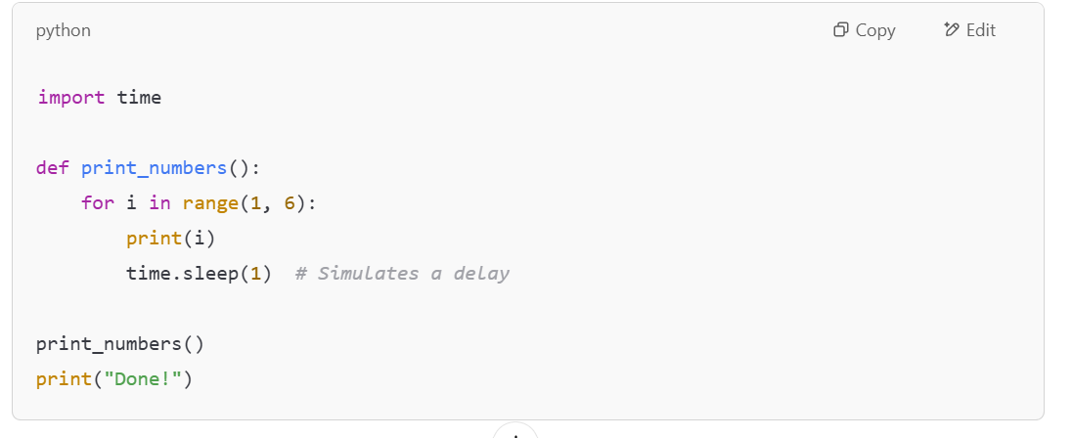
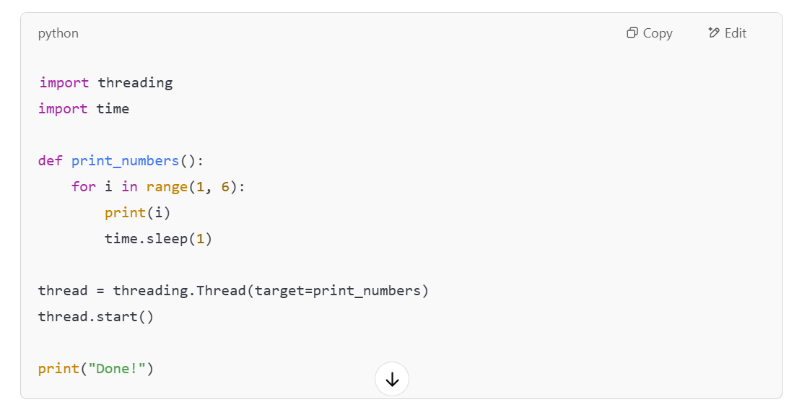
Running Code Without and With Threading
Without Threading:
Run the code and discuss:
Why does it take 5 seconds to finish?
With Threading:
Run the code and discuss: Why does "Done!" print before the numbers finish printing?

Slide 6
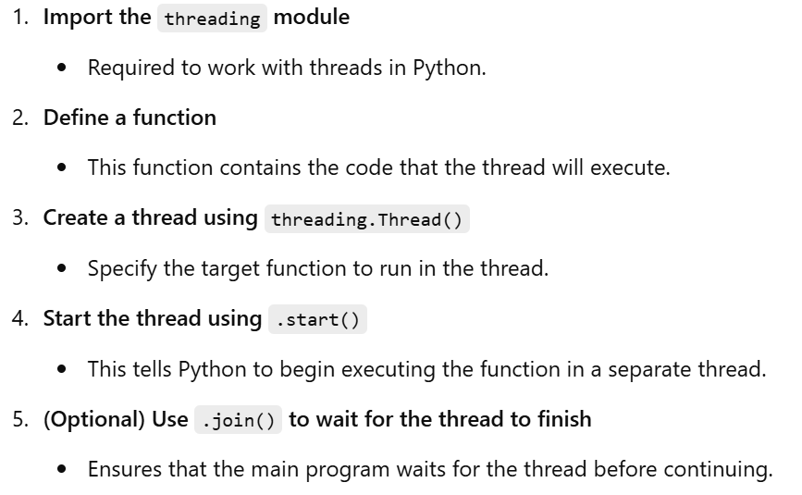
How to Create and Start a Thread in Python

Slide 7
HANDS-ON QUIZ TIME (90 minutes)
Do Workshop 6 Activity 1 - Threading

Slide 8
Feedback Control
(1 hour lesson 2 hours hands-on coding activity)

Slide 9
Introduction to Feedback Control
What is Feedback Control?
Feedback control is a system where outputs are measured and used to adjust inputs in real time to maintain a desired state. It is widely used in robotics, automation, and computer vision applications.
Examples of Feedback Control in Everyday Life:
Thermostats: A thermostat detects the room temperature and adjusts the heater or air conditioner to maintain the set temperature.
Cruise Control in Cars: A car adjusts its speed automatically based on road conditions and speed limits.
Autonomous Drones: Drones adjust their altitude, position, and movement based on real-time sensor data and images data.

Slide 10
Feedback Control in Drones
Drones use various types of feedback control mechanisms:
Position Control: Uses GPS or computer vision to keep the drone in a specific location.
Altitude Control: Uses barometers or visual markers to maintain a constant height.
Object Tracking: Uses cameras and computer vision to follow a target (e.g., a person or a ball).

Slide 11
Why Use Computer Vision for Drone Control?
GPS is not reliable indoors, or may not even work indoor.
Most drones have cameras. Vision-based tracking enables drones to follow objects dynamically.
Useful in applications like autonomous delivery, security, and sports analysis.

Slide 12
How Drones Adjust Their Movement Based on a Target's Location
Drones use computer vision to analyze video frames from their onboard cameras.
By identifying the target’s position in the frame, the drone can decide how to adjust its movement.

Slide 13
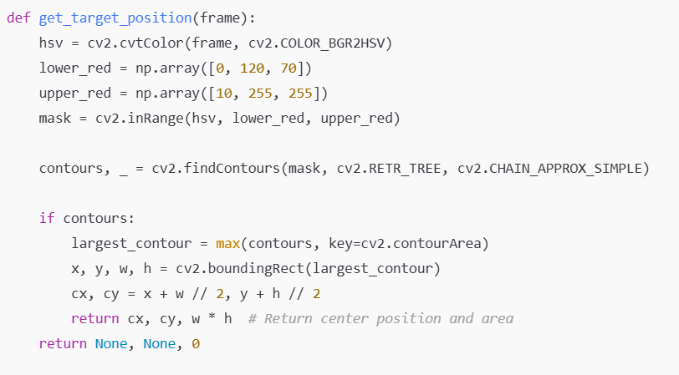
Recap: Color and Sharp Detection
To track an object based on color, we need to:
Convert the image from BGR (OpenCV default) to HSV.
Define a color range in HSV.
Apply a mask to filter out everything except the target color.
Find contours (shapes) of the detected color region.
Draw a bounding box around the object.
Remember the cx, cy!

Slide 14
Understanding the Drone’s Camera View
The drone's camera captures a live video feed, which is essentially a 2D grid of pixels (e.g., 1280x720 pixels).
The center of the detected object is the ideal position where the drone wants to be.
If the detected object is off-center from the center of drone’s camera feed, the drone needs to adjust its position.
The X-axis (left-right) and Y-axis (up-down or forward-backward) of the detected object determines how the drone should move.

Slide 15
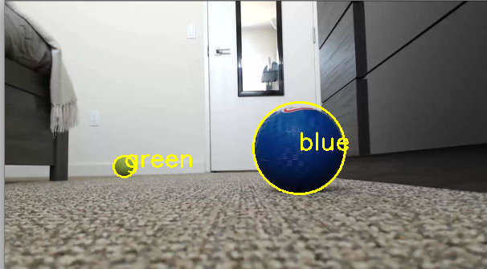
Steps to Align the Drone with the Target
The drone follows these steps:
Detect the target in the camera feed
OpenCV is used to find the target's position (e.g., a red object or an ArUco marker).
Find the center of the detected object (green cross)
Once detected, the bounding box around the target gives the center coordinates (cx, cy).
Compare the target’s position to the drone’s image frame’s center
The center of the image (red cross) is the reference point (e.g., (640, 360) for a 1280x720 resolution).
+
+

Slide 16
Move the drone to correct its position
The red cross is at x = 640 y = 360. Make red cross on green cross by:
If the detected image’s cx (green cross) > 640 (red cross), move right.
If the target is cx (green cross) < 640 (red cross), move left.
If the target is cy (green cross) < 320 (red cross), move up or forward (if camera is tilted down).
If the target is cy (green cross) > 320(red cross), move down or backward (if camera is tilted down).
(x=0, y=0)
x
Y
+
+

Slide 17
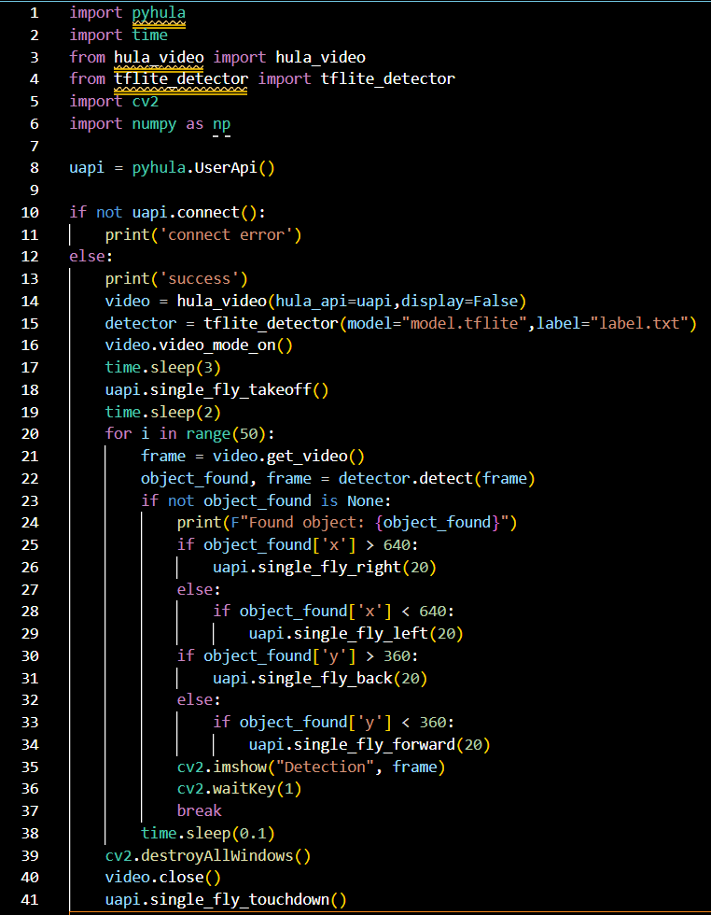
Some codes
Line 24 to Line 34: Reference code to show you the idea on how to code moving the drone using the image position.
This sample code is W6-detect-imda-and-align.py.

Slide 18
HANDS-ON QUIZ TIME (2 hours)
Do Workshop 6 Activity 2 - Feedback Control

